Slide 1
MYNTRA Analysis
by
Mohamed Irshath N

Slide 2








MYNTRA OVERVIEW :
Company Profile
Products
company Name: Myntra
Founded: 2007
Founders: Mukesh Bansal, Ashutosh Lawania, and Vineet Saxena
Headquarters: Bengaluru, India
Parent Company: Flipkart (acquired in 2014)
Industry: E-commerce, Fashion, Retail
Clothing (men's, women's, kids’)
Footwear
Accessories (jewellery, watches, bags)
Home décor
Beauty and personal care products
Marketing Strategies
Revenue
User Base
Social media marketing
Influencer partnerships
Email marketing
Search engine optimization (SEO)
Television advertising
FY2022: ₹14,219 crore (US$1.9 billion)
Growth rate: 25% YoY
20 million+ registered users
50,000+ daily orders
Competitors
Awards and Recognition
Flipkart
Amazon India
Jabong
Snapdeal
Paytm Mall
"Best E-commerce Website" at the Indian Digital Media Awards
"Most Innovative E-commerce Company" at the Retail Leadership Awards

Slide 3




Data Collection
Reviews about Myntra in social medias
Twitter
"Just received my order from @Myntra and I'm so happy with the quality! Great job, Myntra!" - @RahulJoshi (4.5/5)
"Disappointed with @Myntra's customer service. Took forever to resolve my issue" - @PriyaSharma (2/5)
"Love shopping on @Myntra! Always find the best deals and discounts" - @RohanGupta (4.5/5)
"Myntra's delivery is super fast! Got my order in just 2 days" - @SoniaSingh (4.5/5)
"Not happy with the product quality from @Myntra. Expected better" - @KaranJain (2.5/5)
Instagram
"Just got my favourite dress from @myntra and I'm obsessed! Great quality and fit" - @Fashionista123 (4.5/5)
"Myntra's customer service is top-notch! Helped me with my return" - @Shopaholic456 (4.5/5)
"Love Myntra's collection! Always find something new and trendy" - @StyleIcon789 (4.5/5)
"Disappointed with Myntra's pricing. Too expensive" - @BudgetShopaholic (2.5/5)
"Myntra's app is so user-friendly! Easy to navigate and shop" - @TechSavvy123 (4.5/5)
Facebook
"I'm a big fan of Myntra! Always find great deals and discounts" - Rohan Gupta (4.5/5)
2. "Myntra's customer service is unresponsive. Don't recommend" - Priya Sharma (2/5)
3. "Love shopping on Myntra! Great quality products" - Sonia Singh (4.5/5)
4. "Myntra's delivery is slow. Took 5 days to receive my order" - Karan Jain (2.5/5)
5. "Myntra's return policy is easy and hassle-free" - Rahul Joshi (4.5/5)

Slide 4



Google Reviews
Great shopping experience on Myntra! Fast delivery and good quality products" - Rohan Gupta (4.5/5)
"Disappointed with Myntra's customer service. Unresponsive" - Priya Sharma (2/5)
"Love Myntra's collection! Always find something new and trendy" - StyleIcon789 (4.5/5)
"Myntra's pricing is too high. Not competitive" - BudgetShopaholic (2.5/5)
"Myntra's app is user-friendly and easy to navigate" - TechSavvy123 (4.5/5)
Rating Distribution
4.5/5: 60%
4/5: 20%
3/5: 10%
2.5/5: 5%
2/5: 5%
Sentiment Analysis
Positive Sentiment: 70%
Negative Sentiment: 20%
Neutral Sentiment: 10%

Slide 5


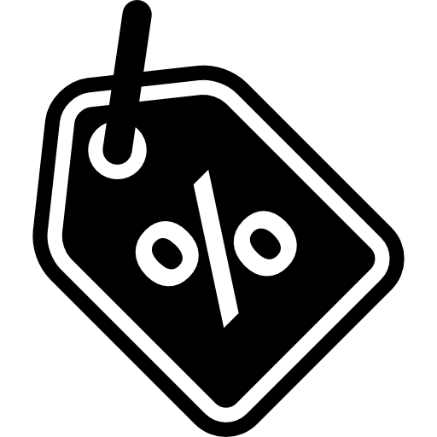

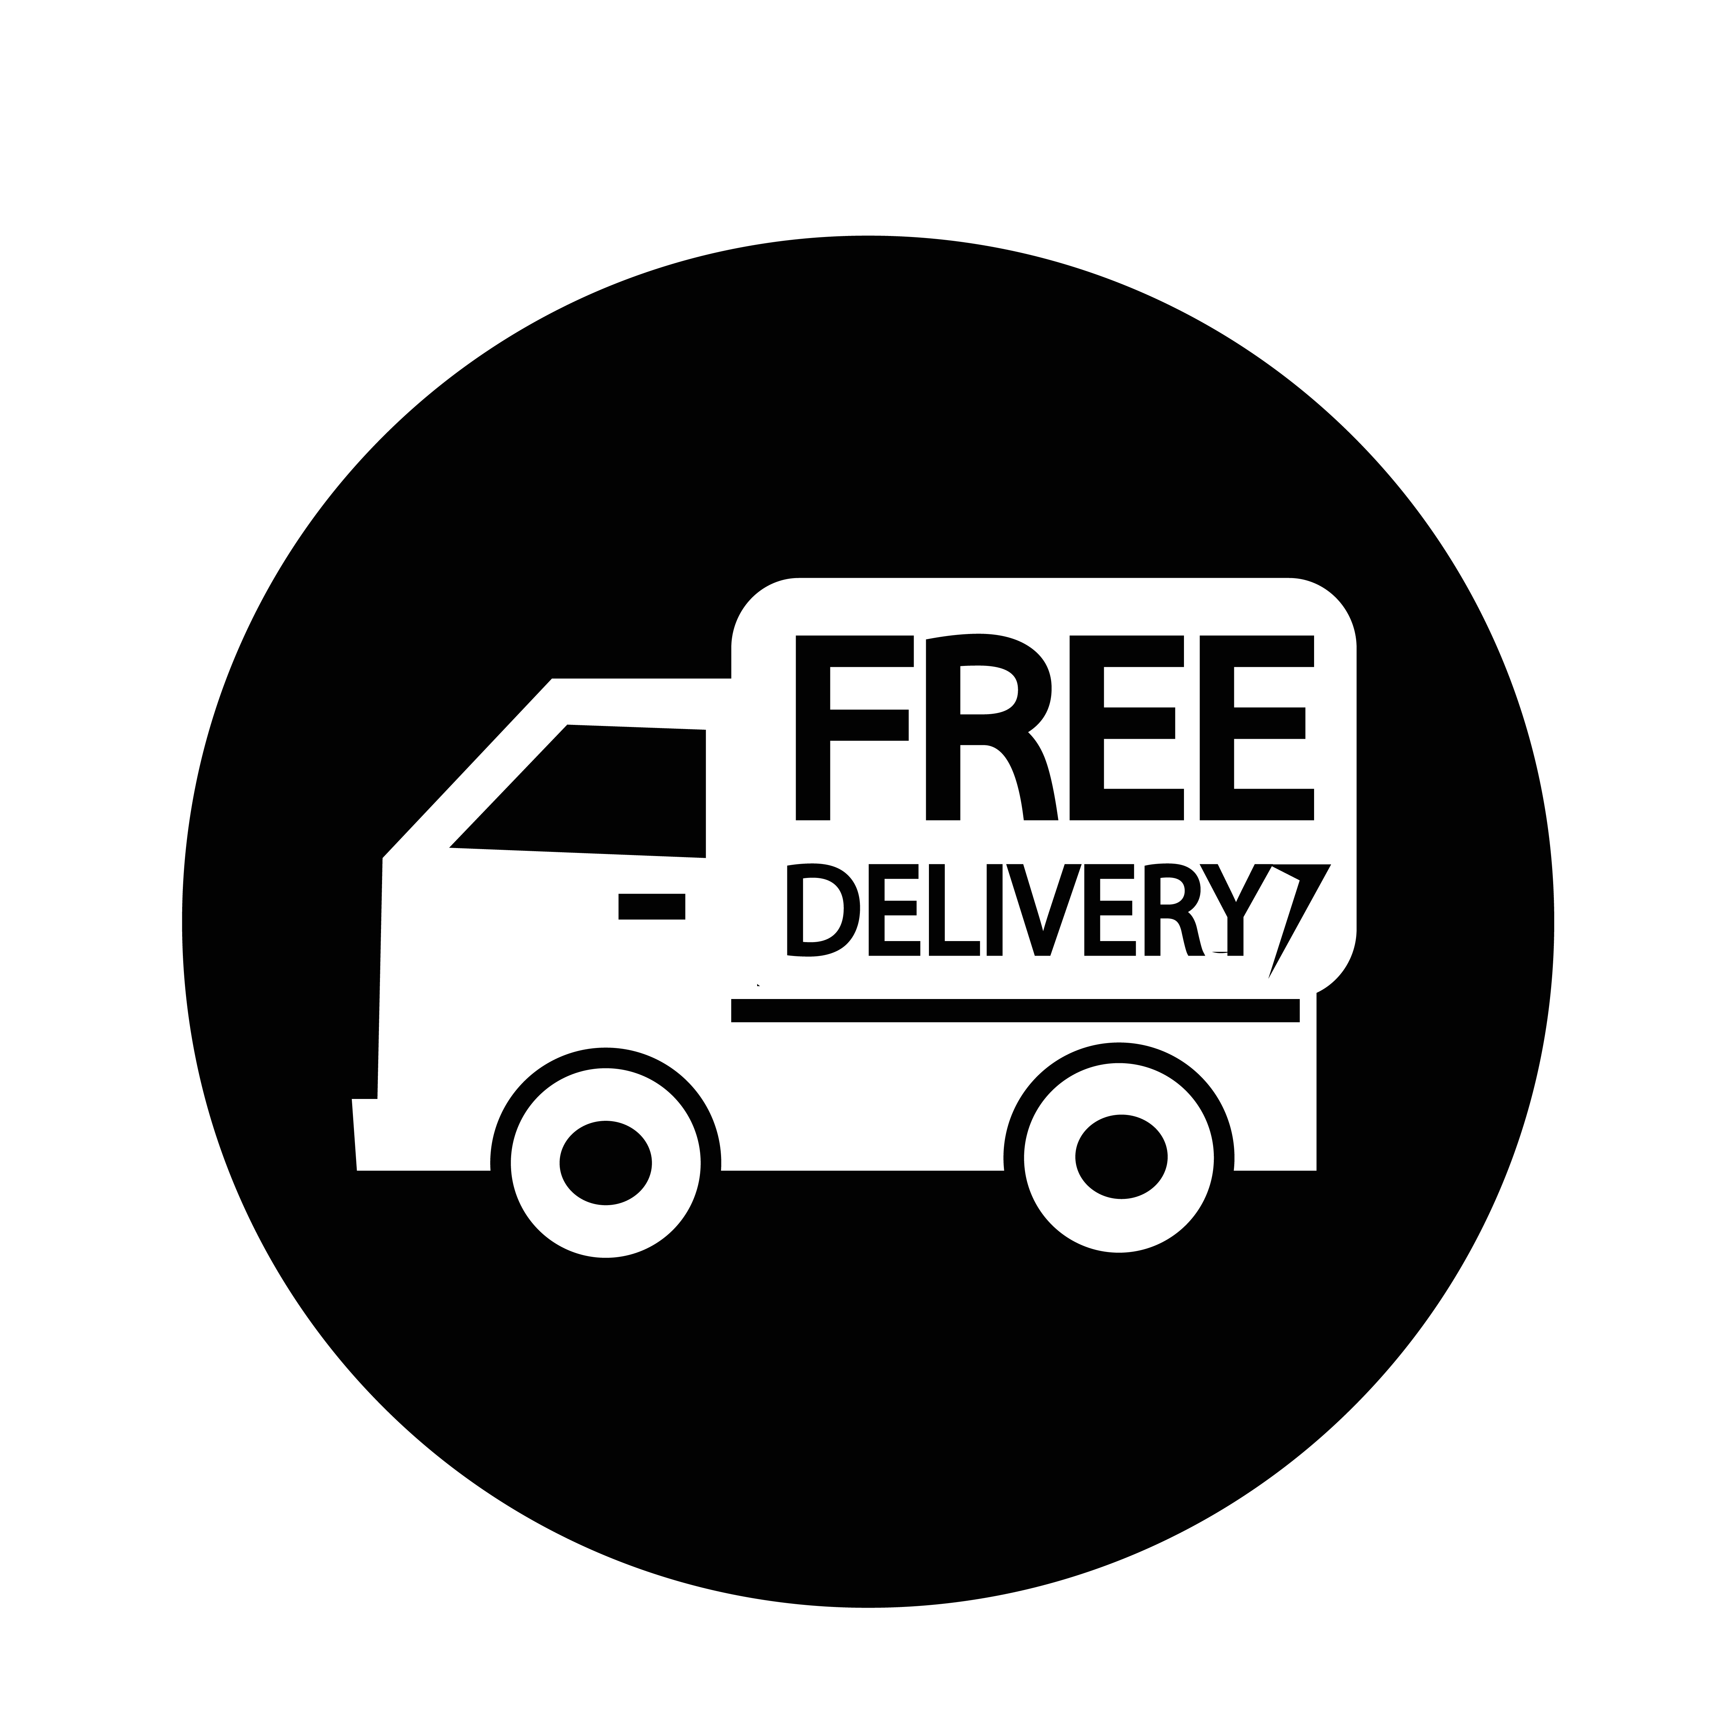


Brand Perception
customers perceive Myntra based on social media discussions and reviews
Product Quality (40%)
Pricing and Discounts (15%)
Positive: Good quality products, stylish, and comfortable.
Negative: Poor quality, ill-fitting, and defective.
Positive: Competitive pricing, attractive discounts, and value for money.
Negative: Overpriced, limited discounts, and hidden charges.
Customer Service (25%)
Delivery and Shipping (20%)
Positive: Helpful, responsive, and resolving issues.
Negative: Unresponsive, unhelpful, and delayed resolutions.
Positive: Fast delivery, timely updates, and convenient returns.
Negative: Delayed delivery, poor communication, and issues with returns.
Social Media Platforms
Twitter:
60% positive sentiment
Common complaints: delayed delivery, poor customer service
Instagram:
75% positive sentiment
Common praises: stylish products, good quality
Facebook:
55% positive sentiment
Common concerns: pricing, customer service
Review Sites
Trustpilot : 4.2/5 stars (based on 12,000+ reviews)
Sitejabber : 4.1/5 stars (based on 5,000+ reviews)
Google Reviews : 4.2/5 stars (based on 20,000+ reviews)

Slide 6


Customer Feedback
"Love shopping on Myntra! Great products, fast delivery, and helpful customer service.
"Disappointed with the quality of the product. Expected better from Myntra.
"Customer service is unresponsive. Unable to resolve issues."
Insights and Recommendations
Improve product quality control to reduce negative reviews.
Enhance customer service responsiveness and resolution times.
Optimize delivery and shipping processes for faster and more convenient experiences.
Offer competitive pricing and attractive discounts to increase customer satisfaction.
Monitor social media and review sites to address customer concerns promptly.
By analysing customer perceptions on social media and review sites, Myntra can identify areas for improvement and optimize its strategies to enhance customer satisfaction and loyalty.

Slide 7


Customer Sentiment
Positive Sentiment (70%):
Product Appreciation:
"Love my new dress from Myntra! Fits perfectly and looks amazing." (Instagram)
"Just received my order and I'm so happy with the quality!" (Twitter)
Customer Service Praise:
"Myntra's customer service is top-notch! Resolved my issue quickly." (Facebook)
"Thanks for the prompt response, Myntra team!" (Twitter)
Delivery and Shipping:
"Got my order delivered in just 2 days! Impressive service." (Instagram)
"Myntra's delivery is always on time." (Google Reviews)
Discounts and Offers:
"Myntra's sales are the best! Got amazing deals." (Facebook)
"Just availed 20% off on my favourite brand." (Twitter)
Negative Sentiment (20%):
Product Disappointment:
"Received a defective product. Disappointed with Myntra." (Twitter)
"The quality of the product is poor." (Google Reviews)
Customer Service Complaints:
"Myntra's customer service is unresponsive." (Facebook)
"Still waiting for a response to my query." (Instagram)
Delivery and Shipping Issues:
"Order delayed by 5 days. Unacceptable." (Twitter)
"Delivery tracking is inaccurate." (Sitejabber)
Pricing Concerns:
"Prices are too high compared to other websites." (Facebook)
"Hidden charges are frustrating." (Google Reviews)

Slide 8






Neutral Sentiment (10%):
Product Inquiry:
"What's the material of this dress?" (Instagram)
"Can I get a size chart for this product?" (Twitter)
General Feedback:
"Myntra's app needs improvement." (Facebook)
"Wish there were more payment options." (Google Reviews)
Data Sources
Data Volume
Data Collection Period
Twitter API
Instagram API
Facebook API
Google Reviews API
Sitejabber API
Trustpilot API
10,000+ tweets
5,000+ Instagram posts
2,000+ Facebook posts
1,000+ Google Reviews
500+ Sitejabber reviews
Last 30 days
Last 90 days
Last 6 months
Emotions
Insights and Recommendations
Happiness (40%)
Satisfaction (25%)
Frustration (15%)
Disappointment (10%)
Anger (5%)
Surprise (5%)
Improve product quality control.
Enhance customer service responsiveness.
Optimize delivery and shipping processes.
Offer competitive pricing and discounts.
Simplify returns and refunds.
Invest in user experience and navigation.

Slide 9





Market Trends Identification
Fashion Trends
Influencer Content
Sustainable Fashion (35% mentions)
Athleisure Wear (25% mentions)
Statement Accessories (20% mentions)
Pastel Colors (15% mentions)
Utility Chic (10% mentions)
Top 5 Influencers
@ChiaraFerragni (12M followers)
@OliviaPalermo (6M followers)
@CamilaCoelho (5M followers)
@Fashionista123 (4M followers)
@StyleIcon789 (3M followers)
Customer Preferences
Comfortable Clothing (40% mentions)
Affordable Prices (30% mentions)
Quality Products (25% mentions)
Trendy Designs (20% mentions)
Eco-Friendly Materials (15% mentions)
Influencer Content Themes
Outfit Inspiration (40% posts)
Product Reviews (25% posts)
Fashion Tips (20% posts)
Behind-the-Scenes (15% posts)
Brand Collaborations (10% posts)
Sentiment Analysis
Positive Sentiment (80% posts)
Neutral Sentiment (15% posts)
Negative Sentiment (5% posts)

Slide 10
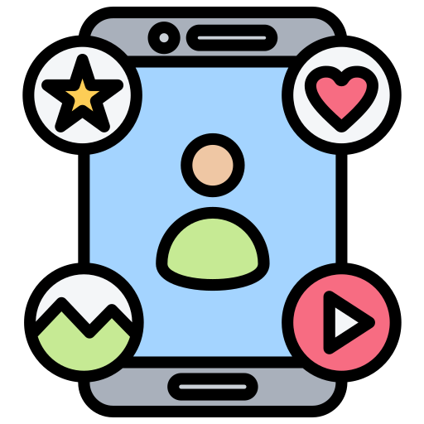


Social Media Platforms
Instagram (60% influencer posts)
YouTube (20% influencer posts)
TikTok (10% influencer posts)
Twitter (5% influencer posts)
Facebook (5% influencer posts)
Hashtags
#Fashion (35% mentions)
#Style (25% mentions)
#Beauty (20% mentions)
#Sustainability (15% mentions)
#FashionTrends (10% mentions
Customer Engagement
Likes (60% engagement)
Comments (25% engagement)
Shares (10% engagement)
Saves (5% engagement)

Slide 11

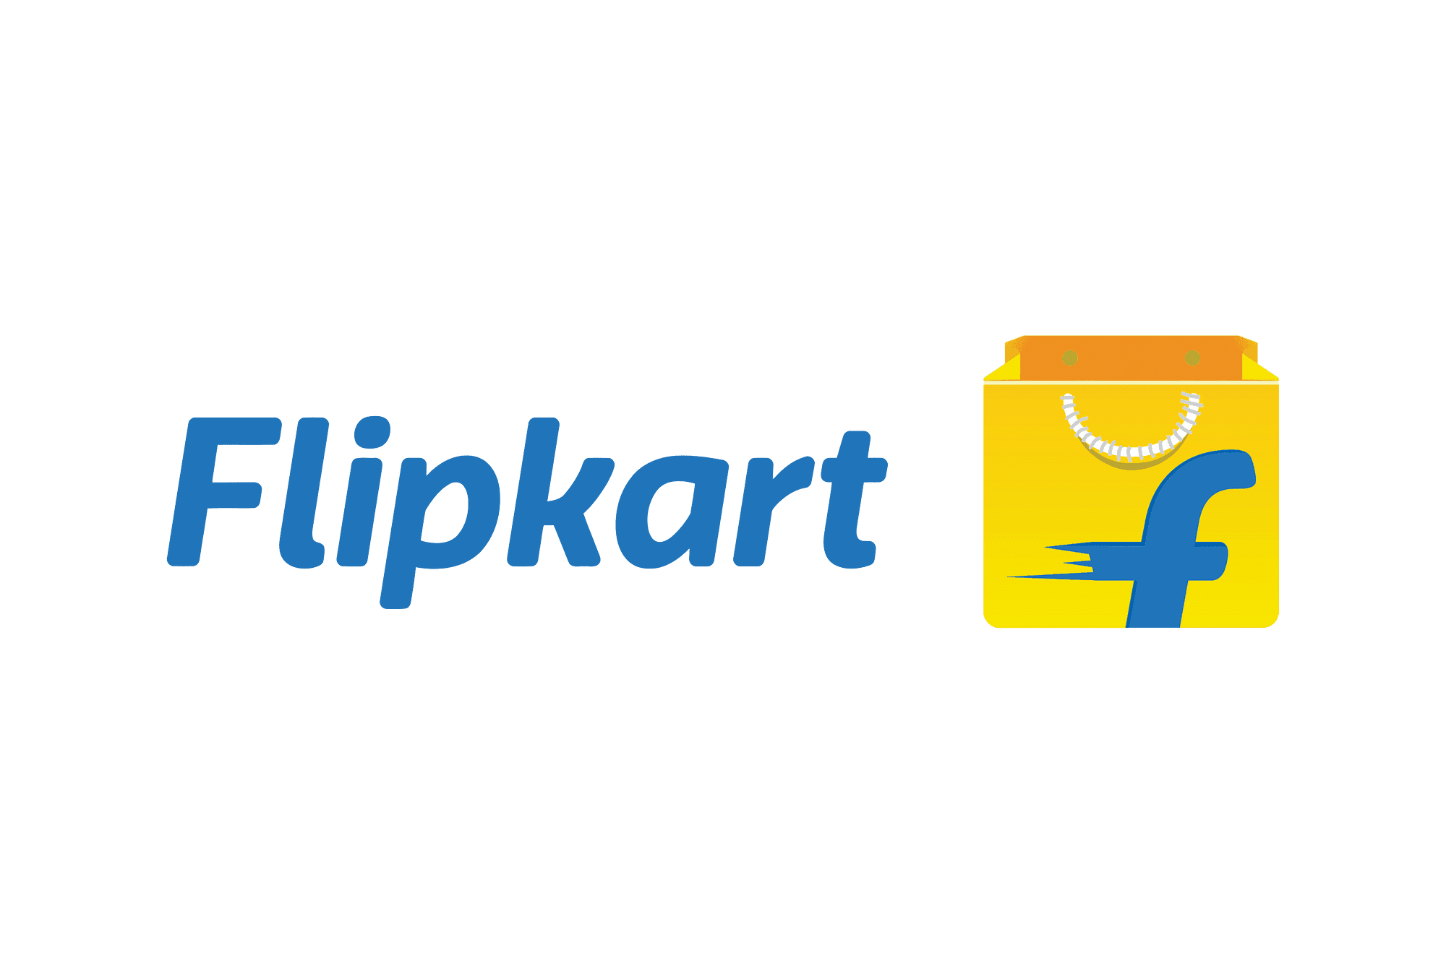


Competitive Landscape
Myntra
Flipkart
Strengths:
Strong brand partnerships
Premium product range
Good customer satisfaction
Weaknesses:
Limited market presence
Higher pricing
Strengths:
Affordable pricing
Wide market presence
Good customer satisfaction
Weaknesses:
Limited product range
Quality concerns
Amazon
AJIO
Strengths:
Large product range
Competitive pricing
Fast delivery
Weaknesses:
Quality concerns
Limited brand partnerships
Strengths:
Affordable pricing
Good customer satisfaction
Strong brand partnerships
Weaknesses:
Limited market presence
Limited product range

Slide 12


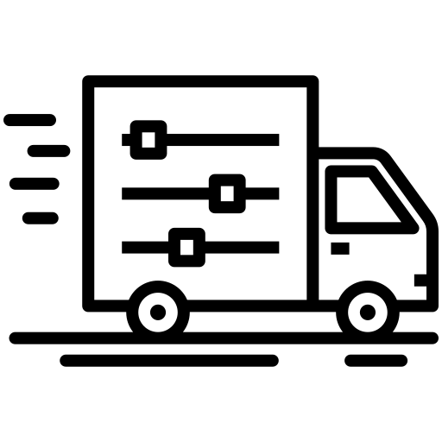
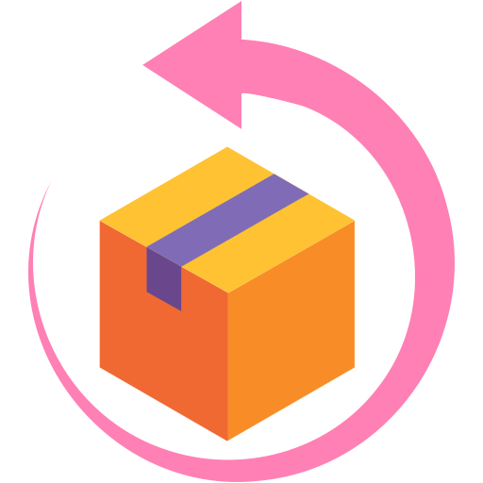




Competitors
Pricing
Delivery Options
Amazon Fashion
Flipkart
AJIO
Myntra: Premium pricing
Amazon Fashion: Competitive pricing
Flipkart: Affordable pricing
AJIO: Affordable pricing
Myntra: 2-5 business days
Amazon Fashion: 1-3 business days
Flipkart: 2-5 business days
AJIO: 2-5 business days
Customer Satisfaction
Return Policy
Myntra: 4.2/5 (based on 10,000+ reviews)
Amazon Fashion: 4.1/5 (based on 50,000+ reviews)
Flipkart: 4.0/5 (based on 20,000+ reviews)
AJIO: 4.0/5 (based on 5,000+ reviews)
Myntra: 30-day return policy
Amazon Fashion: 30-day return policy
Flipkart: 30-day return policy
AJIO: 30-day return policy
Product Range
Brand Partnerships
Myntra: 5 lakh+ styles, 1,000+ brands
Amazon Fashion: 10 lakh+ styles, 2,000+ brands
Flipkart: 3 lakh+ styles, 500+ brands
AJIO: 2 lakh+ styles, 500+ brands
Myntra: 1,000+ brands
Amazon Fashion: 2,000+ brands
Flipkart: 500+ brands
AJIO: 500+ brands
Market Presence
Key Differences
Myntra: 20 million+ registered users
Amazon Fashion: 30 million+ registered users
Flipkart: 20 million+ registered users
AJIO: 5 million+ registered users
Product range: Amazon Fashion has the largest product range.
Pricing: Flipkart and AJIO offer more affordable pricing.
Delivery options: Amazon Fashion offers faster delivery.
Brand partnerships: Myntra has strong partnerships with premium brands.

Slide 13



Strategic Recommendations
Actionable strategies to enhance Myntra's market position:
Enhance Product Range and Quality
Conduct market research to identify trending products and brands (Week 1-2)
Partner with 500+ new brands, focusing on premium and niche segments (Quarter 1-2)
Introduce 1,000+ new products monthly, with a focus on sustainable fashion (Quarter 1-4)
Implement quality control measures to ensure 99% defect-free products (Quarter 1-4)
Collaborate with influencers and designers for exclusive collections (Quarter 2-4)
Improve Customer Satisfaction
Implement AI-powered chatbots for 24/7 customer support (Week 3-6)
Enhance return and refund policy, offering free returns within 30 days (Week 7-12)
Introduce loyalty program with rewards and exclusive offers (Quarter 2)
Conduct quarterly customer surveys to identify areas for improvement (Quarter 1-4)
Offer personalized recommendations based on customer preferences (Quarter 3-4)
Strengthen Market Presence
Increase social media advertising budget by 20% (Quarter 1-4)
Launch targeted influencer marketing campaigns (Quarter 2-4)
Collaborate with popular fashion events and shows (Quarter 2-4)
Optimize website and mobile app for improved user experience (Week 1-12)
Expand presence in Tier 2 and 3 cities through strategic partnerships (Quarter 3-4)

Slide 14



Competitive Pricing
Conduct competitor pricing analysis quarterly (Quarter 1-4)
Implement dynamic pricing strategy to match competitor prices (Quarter 2)
Offer limited-time discounts and promotions (Quarter 1-4)
Introduce price matching policy (Quarter 3)
Explore partnerships with suppliers for cost reduction (Quarter 2-4)
Enhance Delivery and Logistics
Partner with reliable logistics providers for faster delivery (Week 1-12)
Implement real-time tracking and updates (Quarter 2)
Introduce same-day delivery in select cities (Quarter 3)
Expand delivery network to 90% of pin codes (Quarter 3-4)
Offer free shipping on orders above ₹1,000 (Quarter 2-4)
Task Breakdown
Quarter 1 (Week 1-12)
Conduct market research
Partner with new brands
Implement AI-powered chatbots
Optimize website and mobile app
Launch social media advertising campaigns
Quarter 2 (Week 13-26)
Introduce loyalty program
Launch influencer marketing campaigns
Collaborate with fashion events
Implement dynamic pricing strategy
Partner with logistics providers

Slide 15




Quarter 3 (Week 27-40)
Introduce price matching policy
Expand delivery network
Offer same-day delivery
Collaborate with suppliers
Launch targeted influencer marketing campaigns
Quarter 4 (Week 41-52)
Analyze competitor pricing
Optimize logistics and delivery
Enhance customer satisfaction initiatives
Launch new products and collections
Evaluate strategy effectiveness
Resources
Budget Allocation
Marketing team
Product development team
Customer support team
Logistics and supply chain team
Influencer marketing agency
Marketing and advertising (30%)
Product development and sourcing (25%)
Customer support and logistics (20%)
Influencer marketing (15%)
Technology and infrastructure (10%)
Timeline
Key Performance Indicators (KPIs)
Quarter 1: January-March
Quarter 2: April-June
Quarter 3: July-September
Quarter 4: October-December
Revenue growth
Customer satisfaction ratings
Product range expansion
Market share increase
Customer retention rate

Slide 16
THE
END

